Slide 1

Trash Classification
DATA 2040 Final Project Screencast
Team TBData 2.5:
Harry Chalfin, Connor Uzzo,
Xiongfeng (Alex) Wang, Shuya Zhang
: bit.ly/2RPGLhr

Slide 2
Introduction
254 millions tons of trash annually in USA
Environmental problem
Unpleasant job -- need for AI solution
Challenges:
Deformed trash
Environment/surroundings

Slide 3
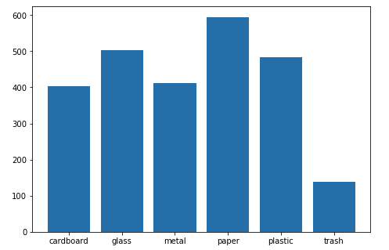
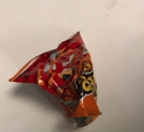
Dataset Description: Thung Data
Paper
595
Glass
502
Plastic
483
Metal
411
Rather clean background
One object in each image
Not deformed
Cardboard
404
Trash
138

Slide 4
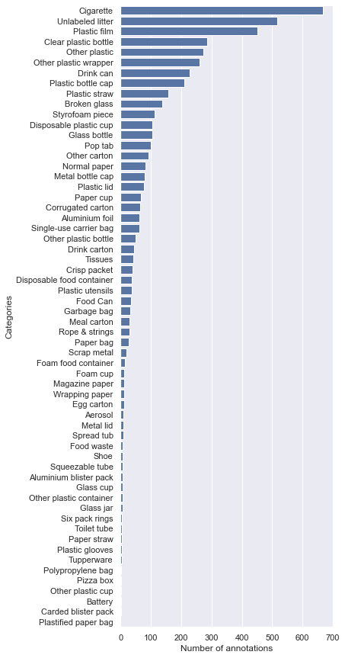
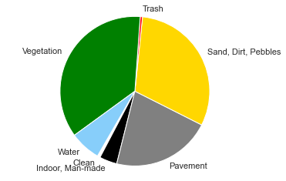
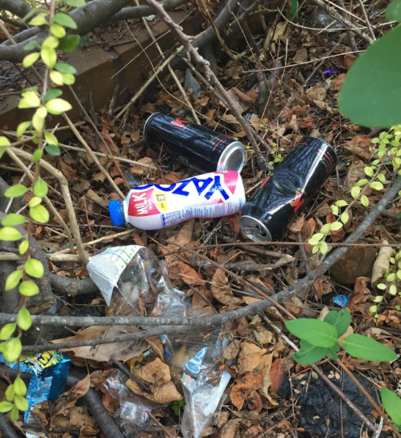
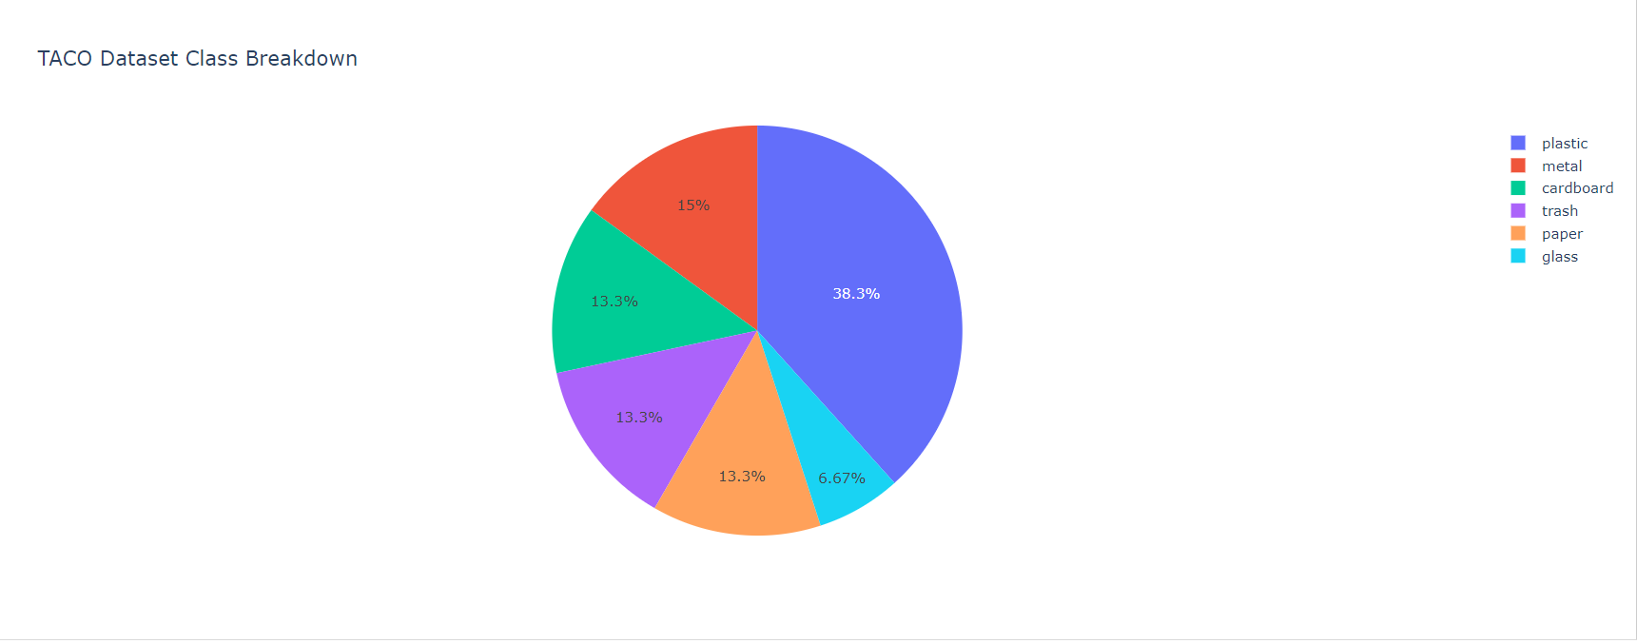
Dataset Description:
TACO (Trash Annotations in Context)
Thung: 2533 samples
TACO: 1500 images, 4782 samples
Combined: 7315 samples

Slide 5
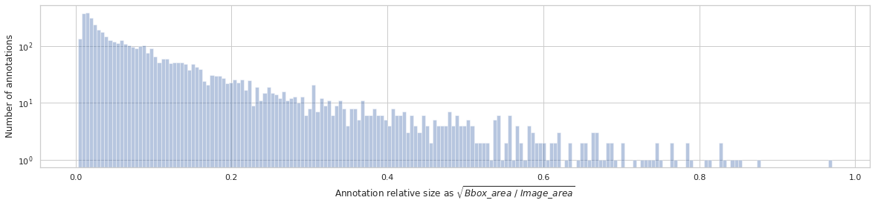
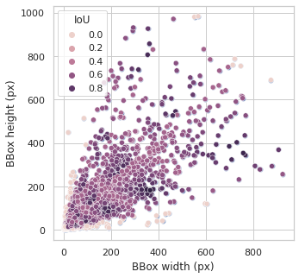
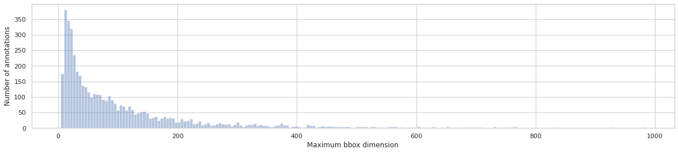
Dataset Description:
TACO (Trash Annotations in Context)

Slide 6
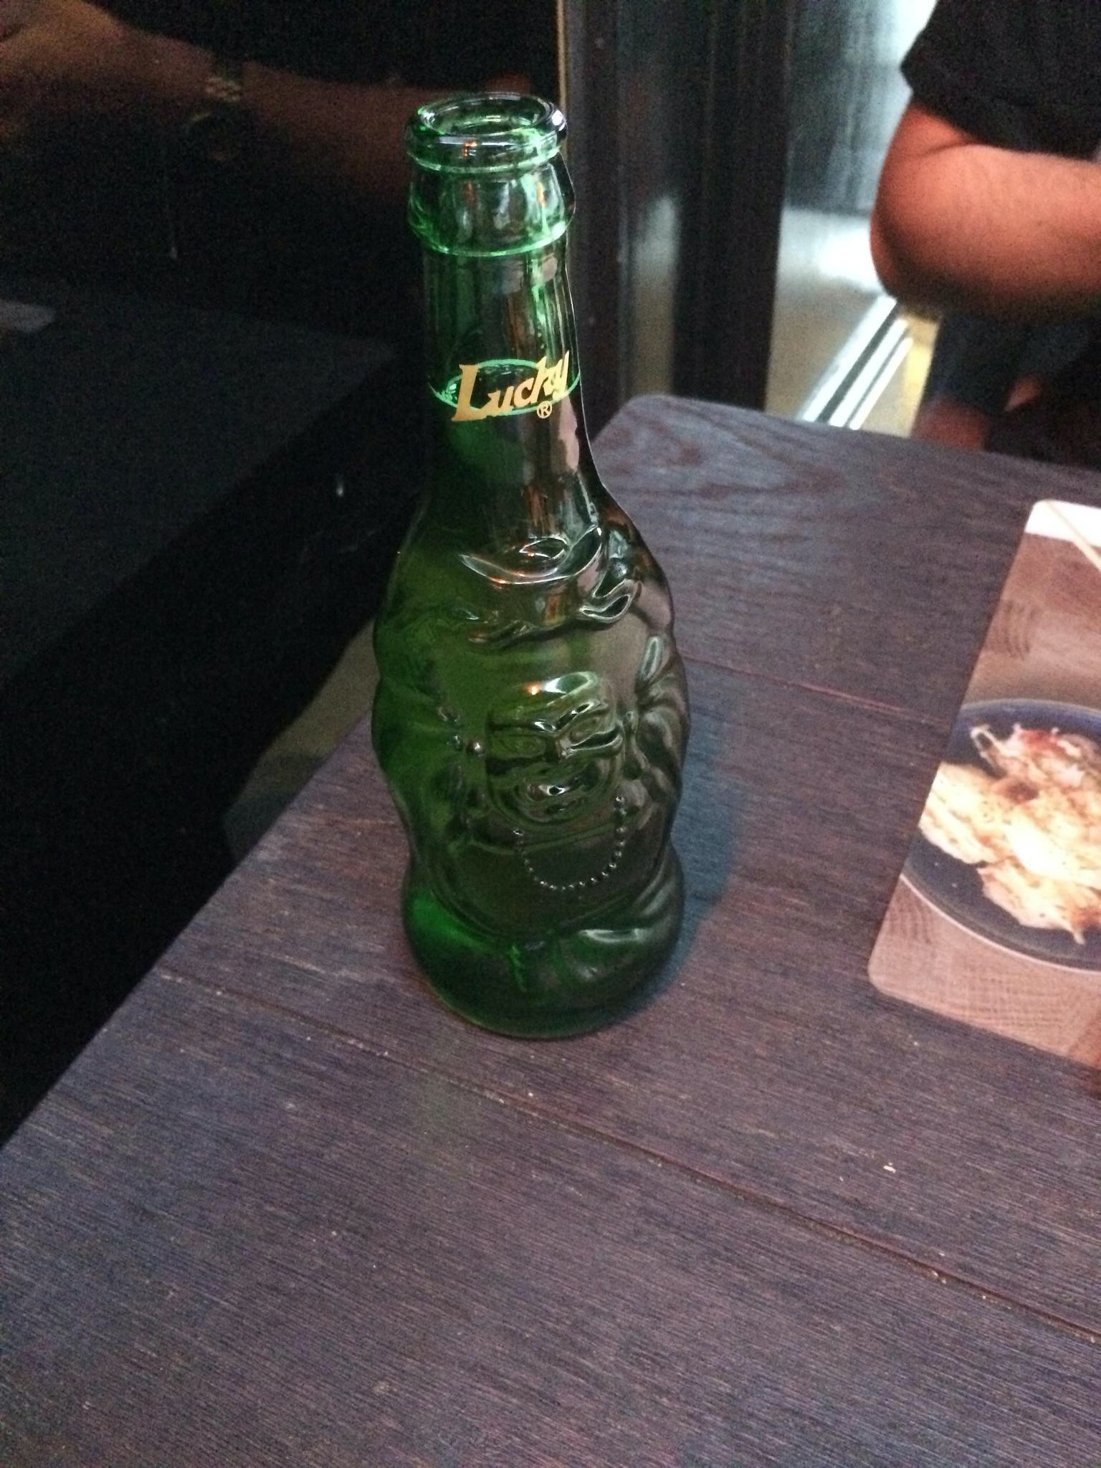
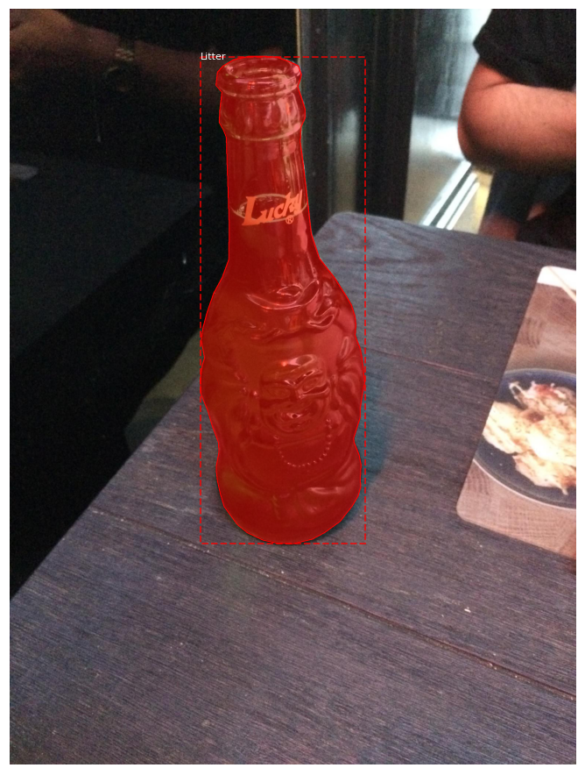
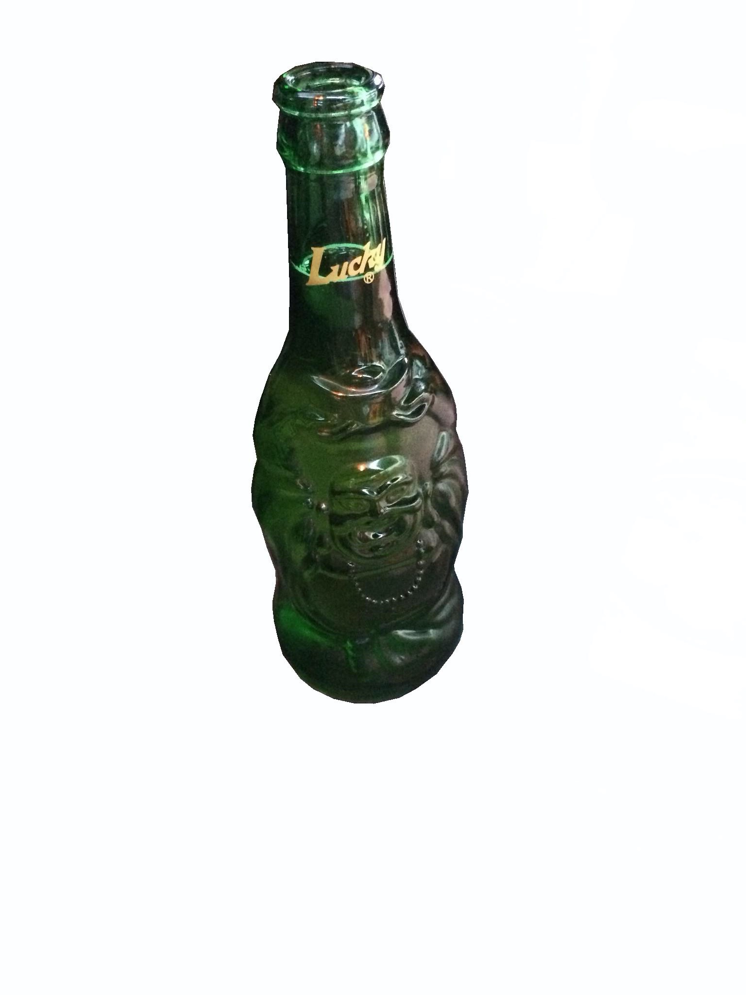
Dataset Engineering:
TACO, Background Removed

Slide 7


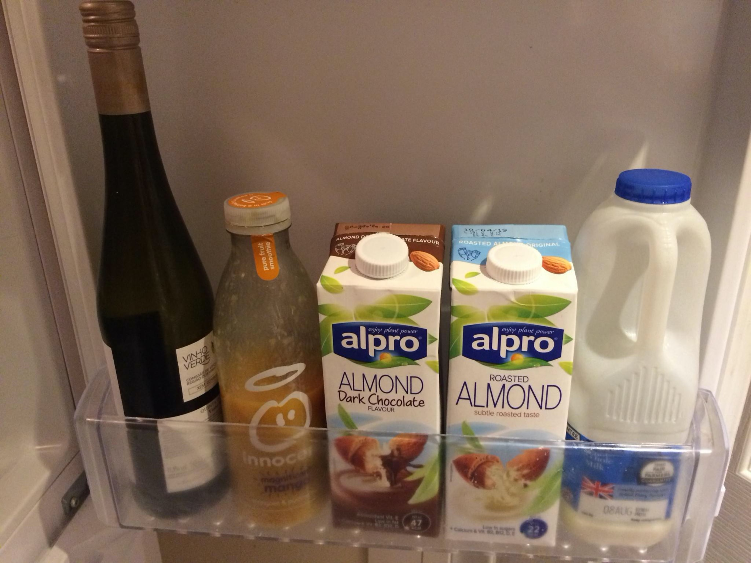


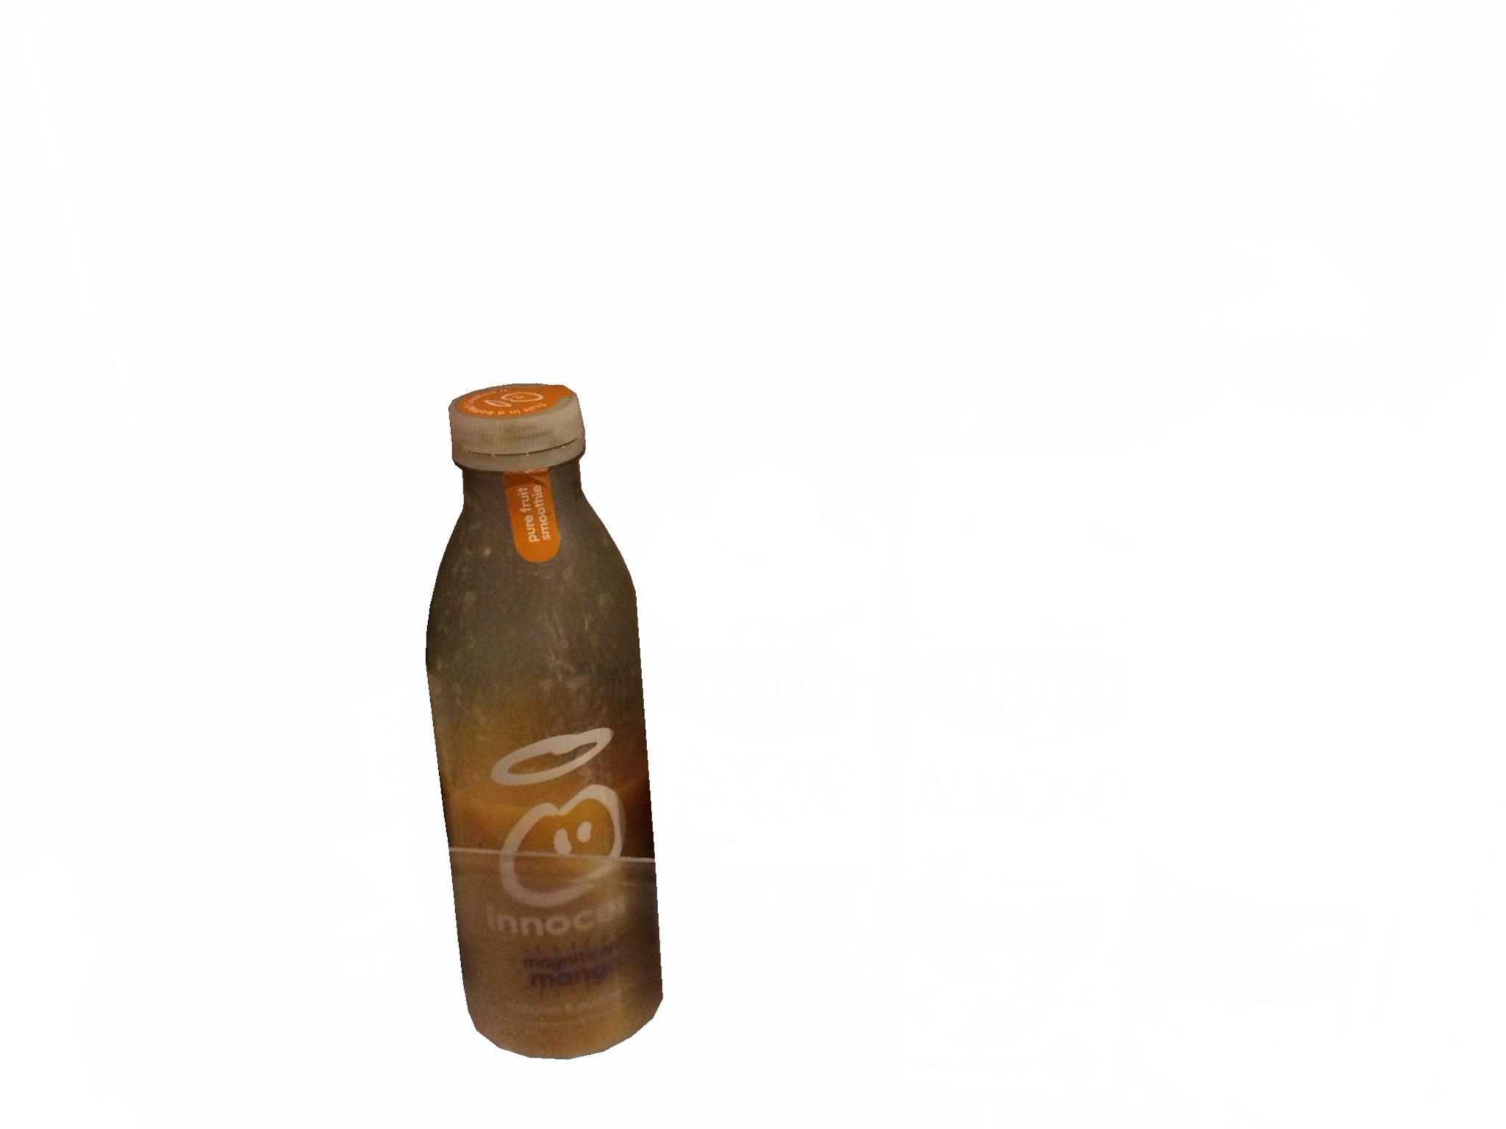

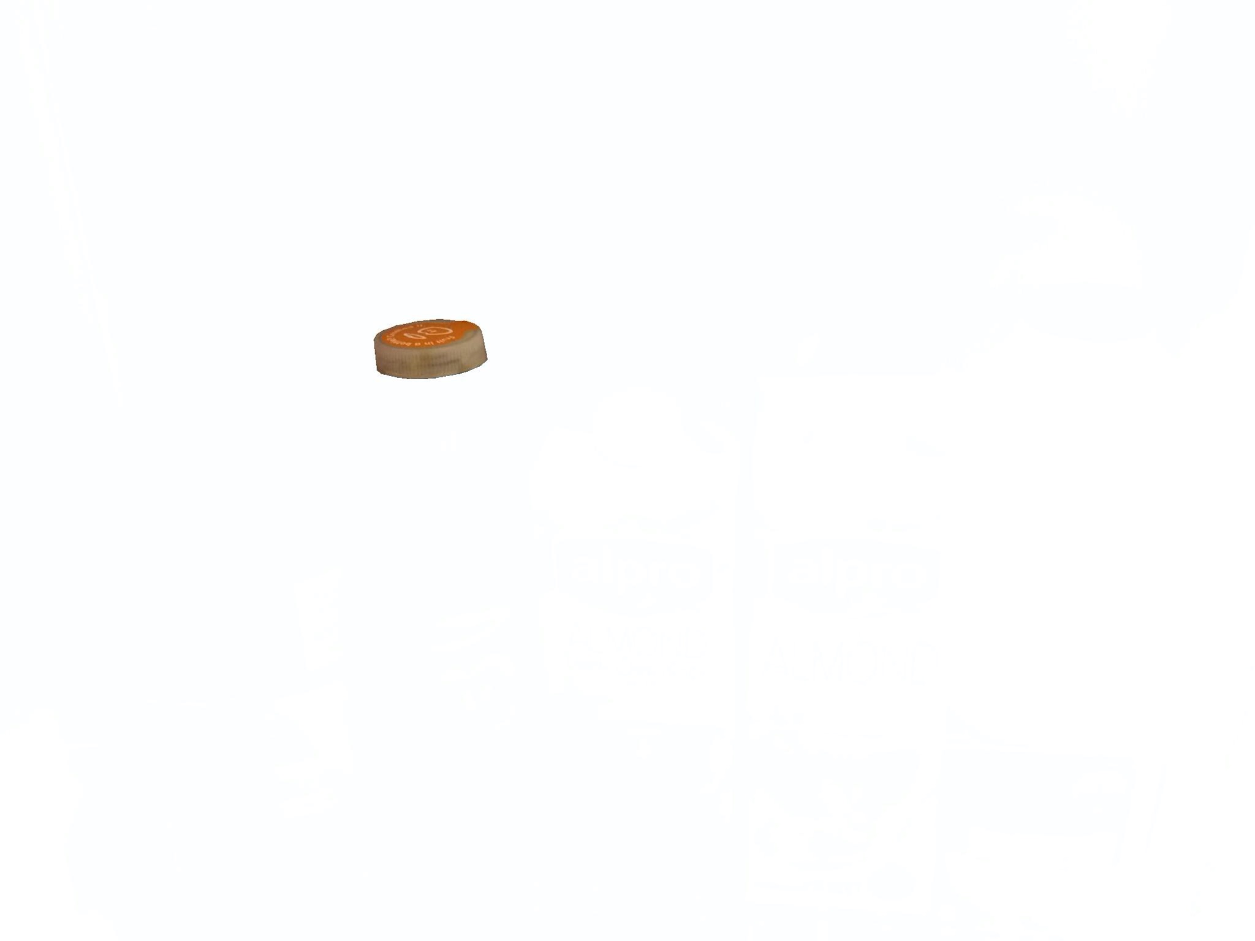
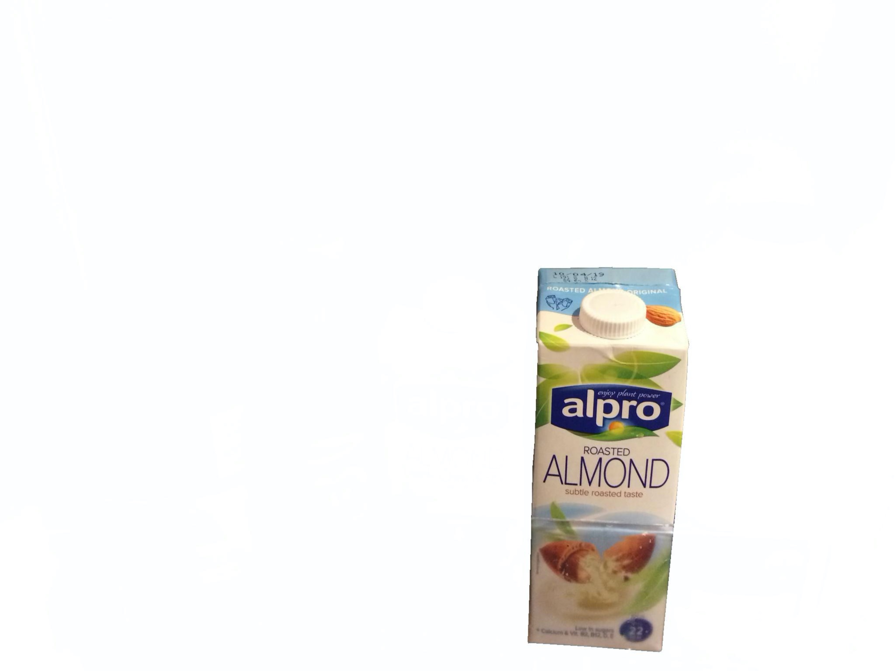
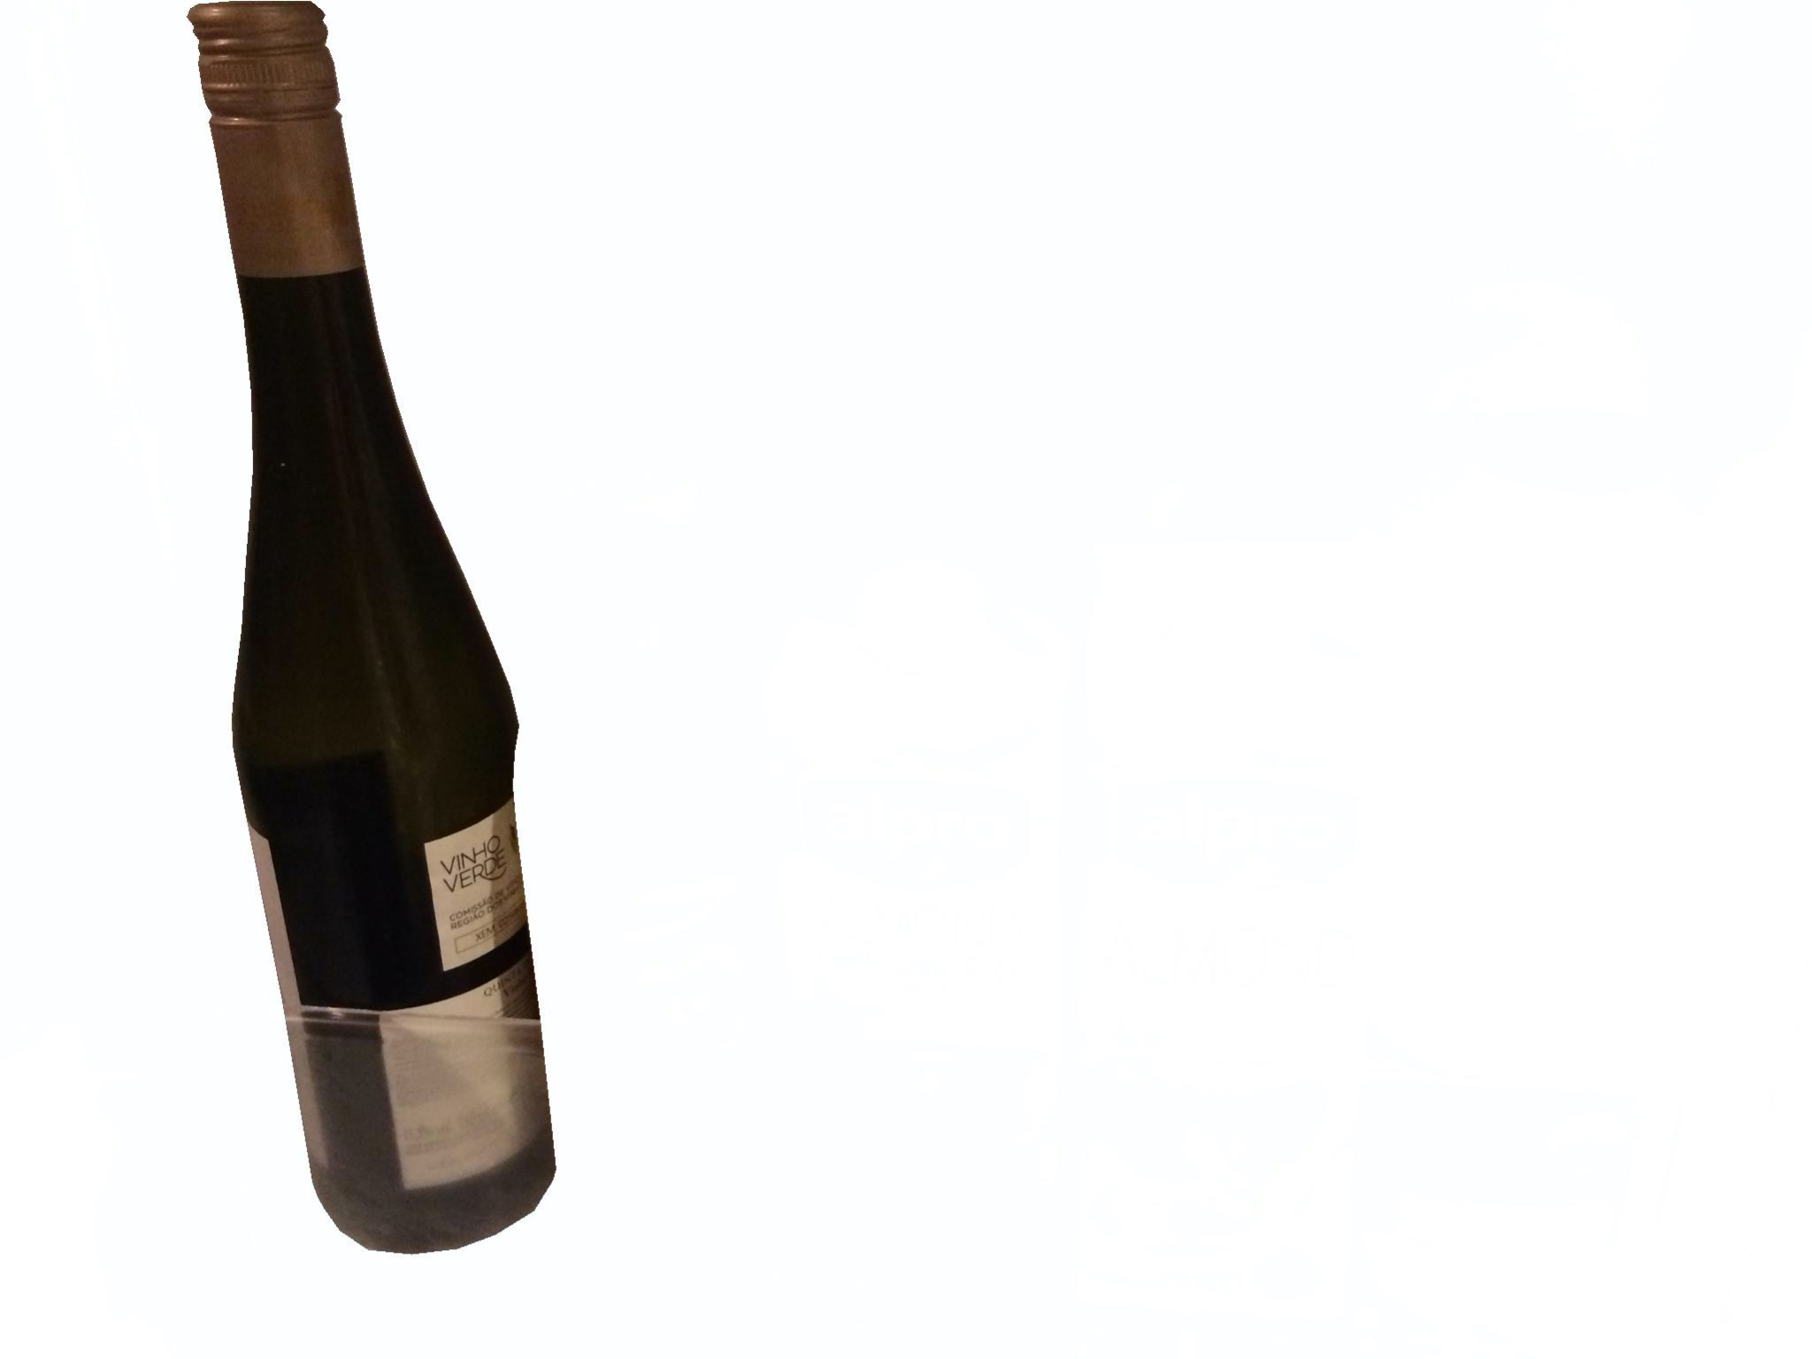
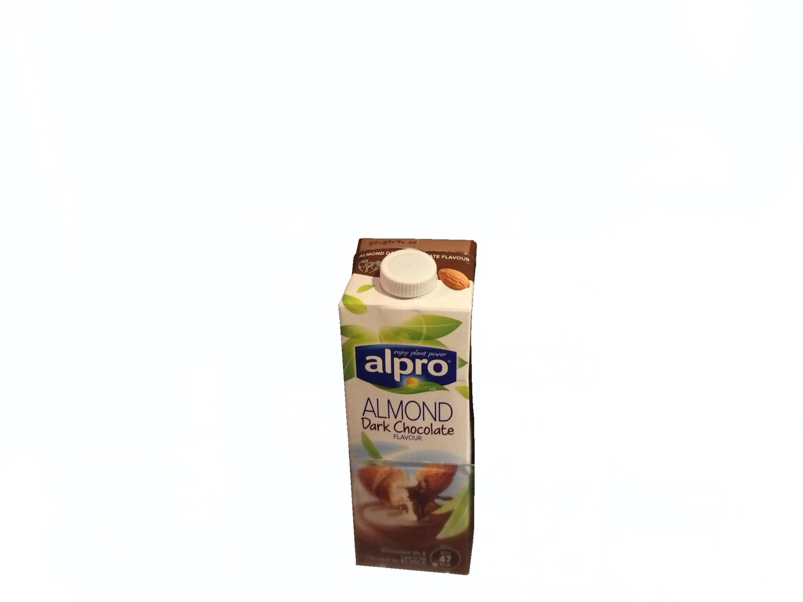
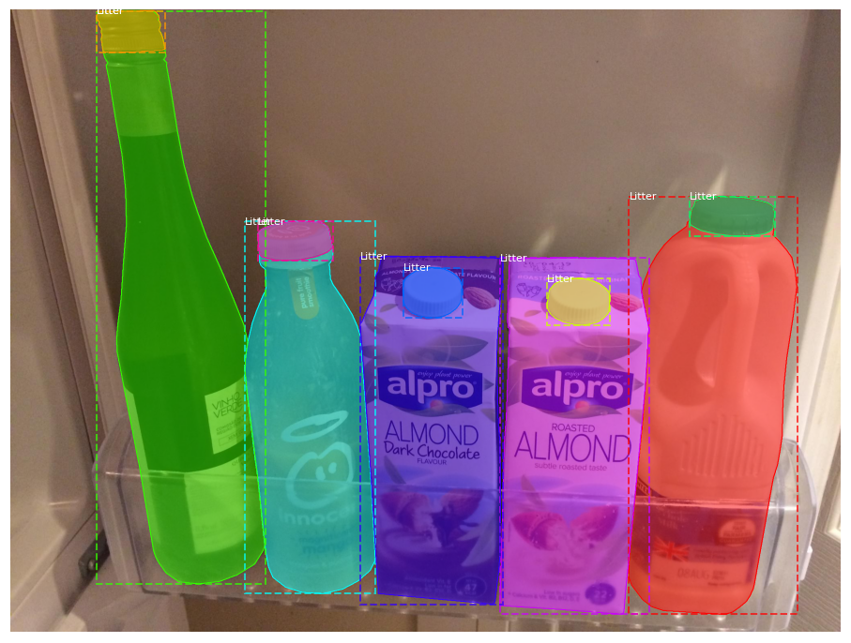
Dataset Engineering:
Multiple Segmentation
Metal
Plastic
Glass
Cardboard

Slide 8
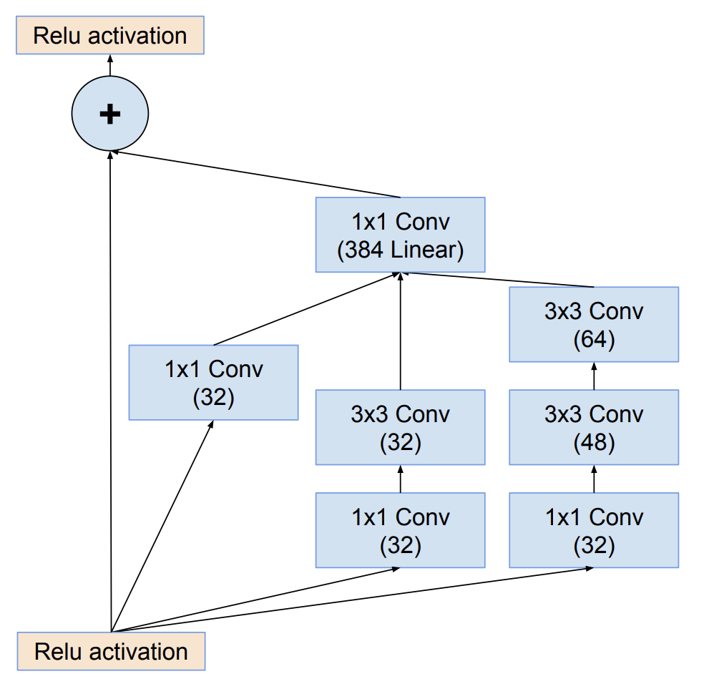
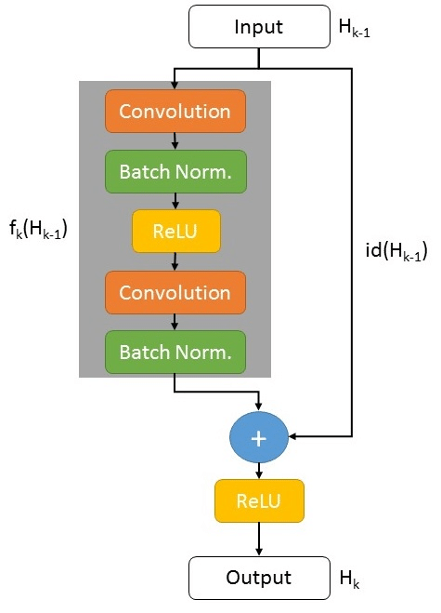
Inception ResNet V2
Inception Architecture: helps the model recognize objects of varying size
Residual Blocks: help the model ignore less significant details of the image
Notes:
Szegedy, Christian, et al. “Inception-v4, Inception-ResNet and the Impact of Residual Connections on Learning.” ArXiv.org, 23 Aug. 2016, arxiv.org/abs/1602.07261v2.
Kumra, Sulabh. Www.researchgate.net, Sept. 2017, www.researchgate.net/figure/Example-of-residual-block-in-ResNet_fig2_310953119.

Slide 9
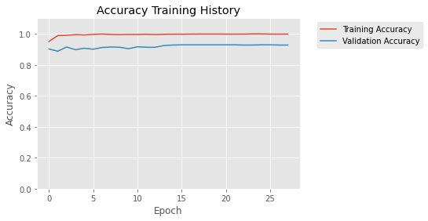
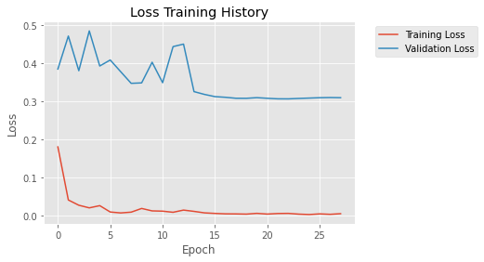
First Model:
Thung Dataset
Training Parameters:
Initial learning rate for regular training = 7e-5, with 0.94 decay rate over 5,000 steps.
For fine tuning, initial learning rate = 7e-7 with 0.96 decay rate over 10,000 steps.
An early stopping callback was also applied, to stop training after 5 epochs of no improvement

Slide 10
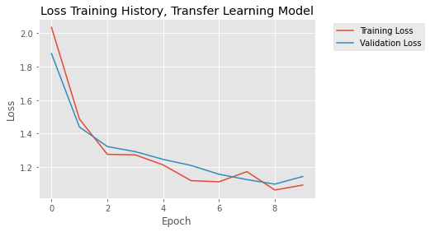
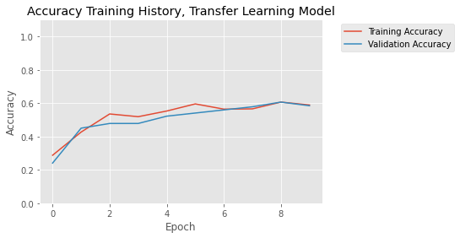
Second Model:
Transfer Learning to TACO Dataset
Training Parameters:
Initial learning rate for regular training = 7e-5, with 0.94 decay rate over 5,000 steps.
For fine tuning, initial learning rate = 7e-7 with 0.96 decay rate over 10,000 steps.
An early stopping callback was also applied, to stop training after 5 epochs of no improvement

Slide 11
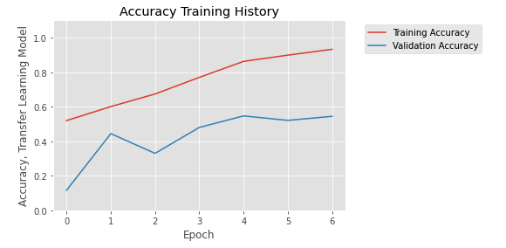
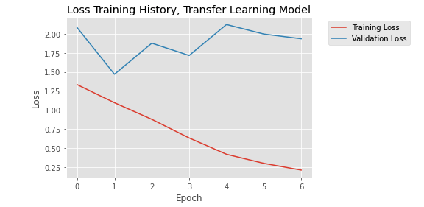
Third Model:
TACO Dataset Without Background
Training Parameters: Same as the one on Thung data
Significant overfitting problem here

Slide 12
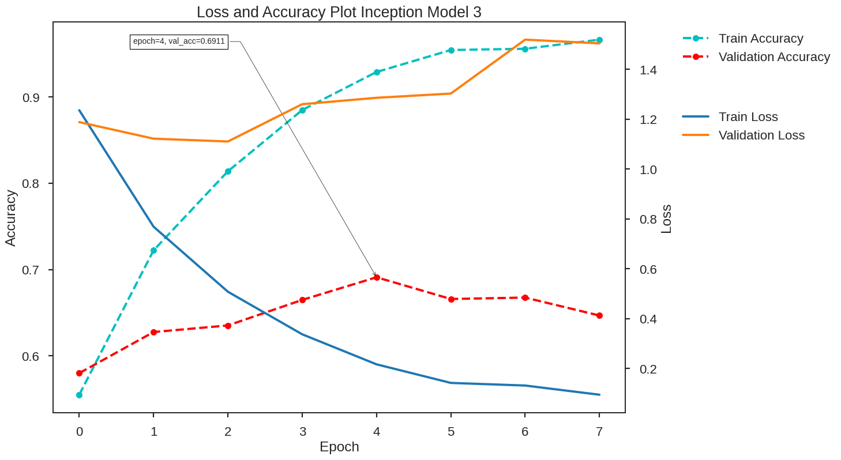
Fourth Model:
Thung + TACO Without Background
5489 training, 1828 testing
initial_learning_rate=7e-5
decay_steps=5000
decay_rate=0.94
earty_stopping _patience=5
Overfitting and potential data not well mixed

Slide 13
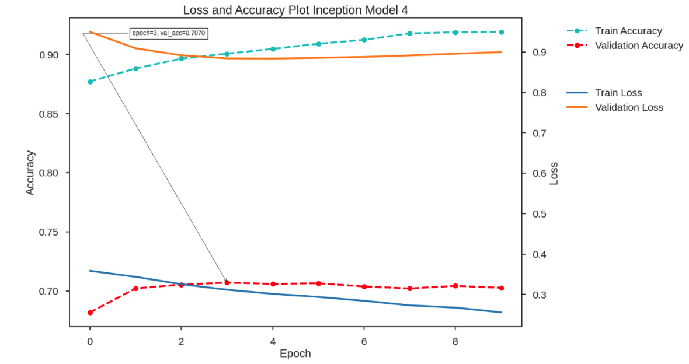
Fourth Model:
Thung + TACO Without Background
initial_learning_rate=7e-7
decay_steps=5000
decay_rate=0.94
earty_stopping _patience=5
Model not training

Slide 14
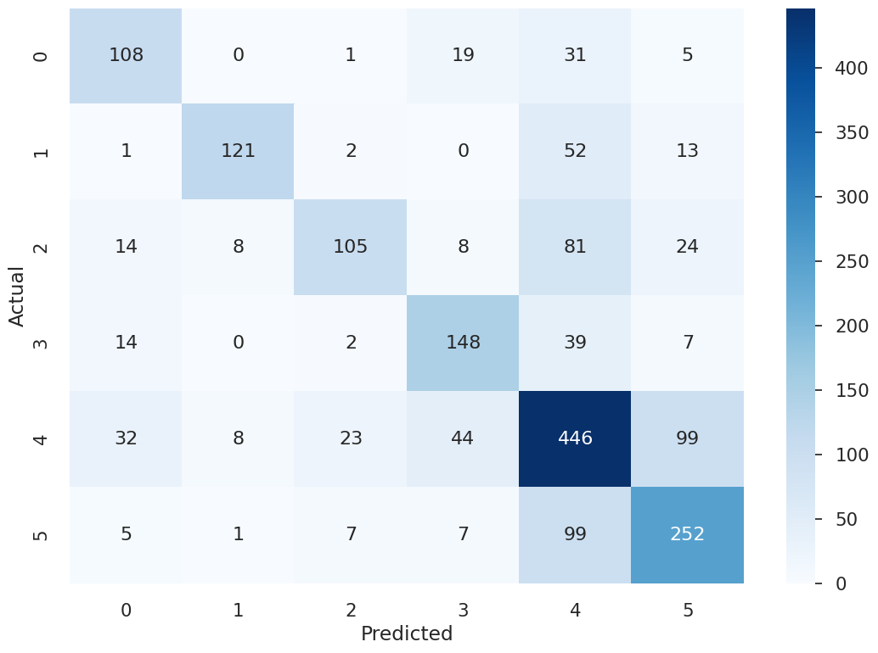
Confusion Matrix
Cardboard
Glass
Metal
Paper
Plastic
Trash

Slide 15

Efforts We Made to Curb Overfitting:
Efforts
Next Steps
Make sure the data are well-mixed
Oversample and change class_weight
Add dense layer and dropouts
Freeze the base and the unfreeze it
Adjust the background color
More investigate into IRN

Slide 16

Future Directions
Improve Fine Detail Recognition
Use a finer image resolution
Common misclassifications were plastic/trash and plastic/glass
Diversify Image Backgrounds
Use multiple datasets with images of trash in different settings
Generalize the model to recognize only the trash object, not the background
Notes:
Hobbs, Andrew. “Why You Could Soon Have a Neural Network on Your Smartphone.” Internet of Business, 14 Feb. 2018, internetofbusiness.com/low-power-neural-network-developed/.

Slide 17

Conclusions
Deep learning can be useful for trash classification
It is much easier to classify images of trash on blank backgrounds than on random backgrounds
The transfer learning model performed about as well as the model trained only on new data
The training on data with its background removed artificially has overfitting problem and needs to be improved.

Slide 18
Citations
Hobbs, Andrew. “Why You Could Soon Have a Neural Network on Your Smartphone.” Internet of Business, 14 Feb. 2018, internetofbusiness.com/low-power-neural-network-developed/.
Kumra, Sulabh. Www.researchgate.net, Sept. 2017, www.researchgate.net/figure/Example-of-residual-block-in-ResNet_fig2_310953119.
Szegedy, Christian, et al. “Inception-v4, Inception-ResNet and the Impact of Residual Connections on Learning.” ArXiv.org, 23 Aug. 2016, arxiv.org/abs/1602.07261v2.
P. F. Proenca and P. Simoes, “Taco: Trash annotations in context for litter detection,” (2020), arXiv:2003.06975 [cs.CV].

Slide 19
Thanks!
Any questions?

